Slide 1
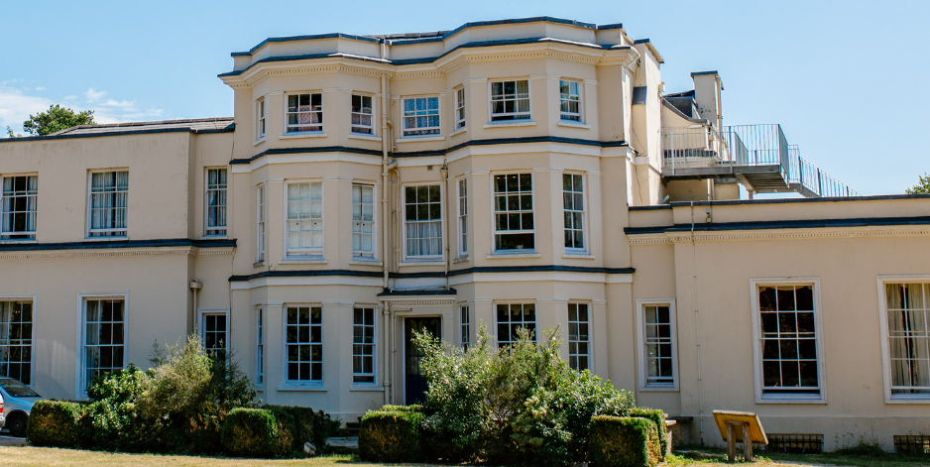
Welcome to the Year 4 Woodrow Parents’ Briefing.
5th-7th March 2025

Slide 2


Slide 3
Staffing
Miss Rutter
Mr Craven
Miss Pugh
Mrs Mills
Contact
If you have any concerns or queries while we are away, please contact the school office who will always be in direct contact with members of staff at Woodrow. Check Facebook page for regular updates.

Slide 4
Safety
Please make sure that you have completed all medical forms and information required.
Woodrow High House has a Duty Instructor on hand 24 hours a day to deal with any problems that might occur while we are away. They will stay over in the house with our group in a separate accommodation area.
There is also always a Duty Manager on call 24/7 and all staff are DBS checked.
The instructor team are all first aid trained and fire marshall qualified.
During activities, 1 member of school staff with each group and one ‘floating member’ alongside 1 or 2 members of trained Woodrow staff.
Children are given a safety briefing alongside instructions before each activity.

Slide 5
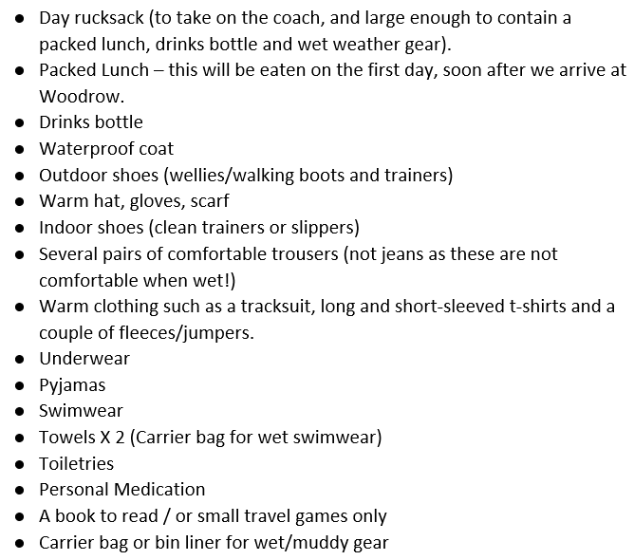
Kit List
Removal of torch and camera from original list.
Sweets in a bag on morning of the trip - not too many please! Keep allergies in mind.

Slide 6
Day of Departure - 5th March
Please arrive at school no later than 8:45am.
Leave by coach at 9–9:15am. Wear outdoor shoes and warm outdoor clothing (to include a waterproof coat).
Packed lunch will be needed in a named disposable bag for eating when we get there. Drinks bottle is required - no glass or fizz please!
Journey time is approximately 40 – 50 minutes.

Slide 7
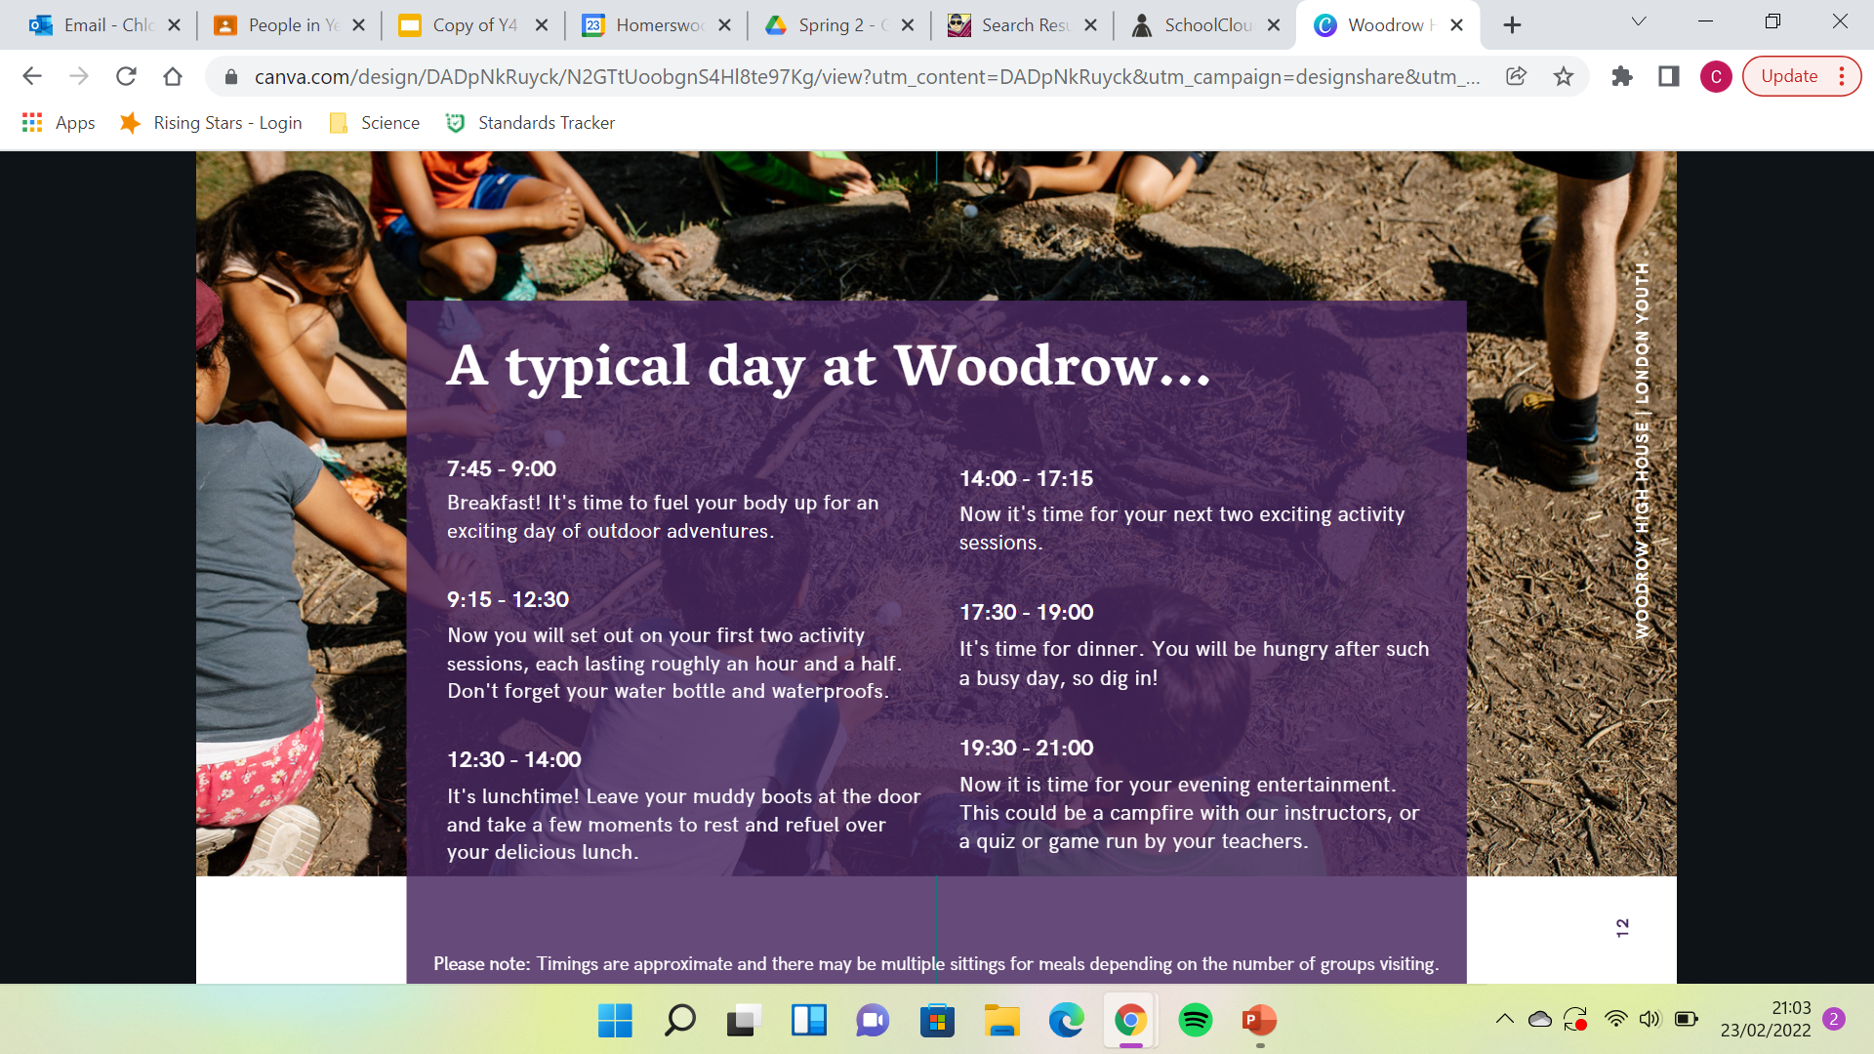

Slide 8




Activity Programme - (not confirmed)
Scavenger hunt
Nightline
Shelter Build
Campfire
Raft build
Raft race
Woodland Walk
Team exercise
Jacob’s ladder

Slide 9
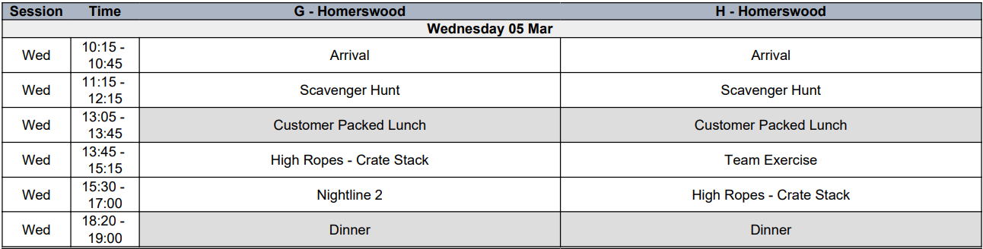
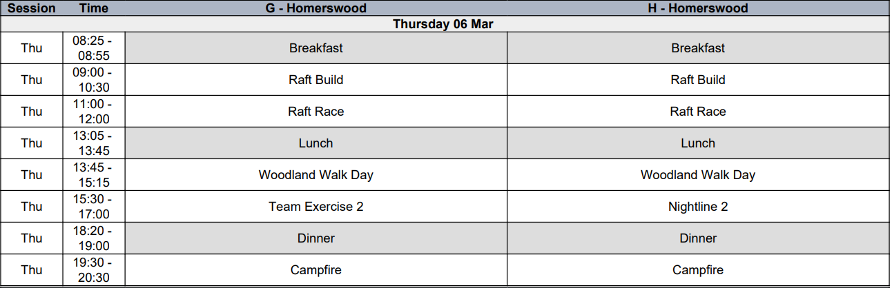

Slide 10
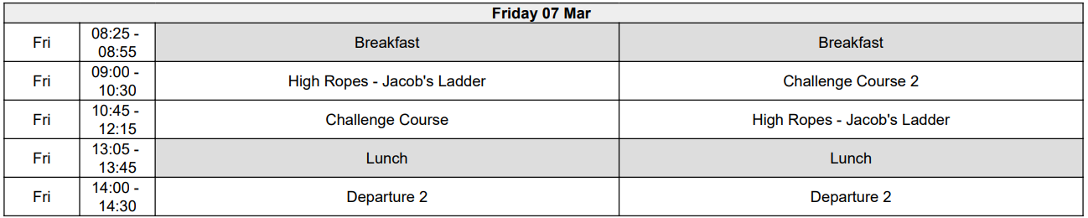

Slide 11
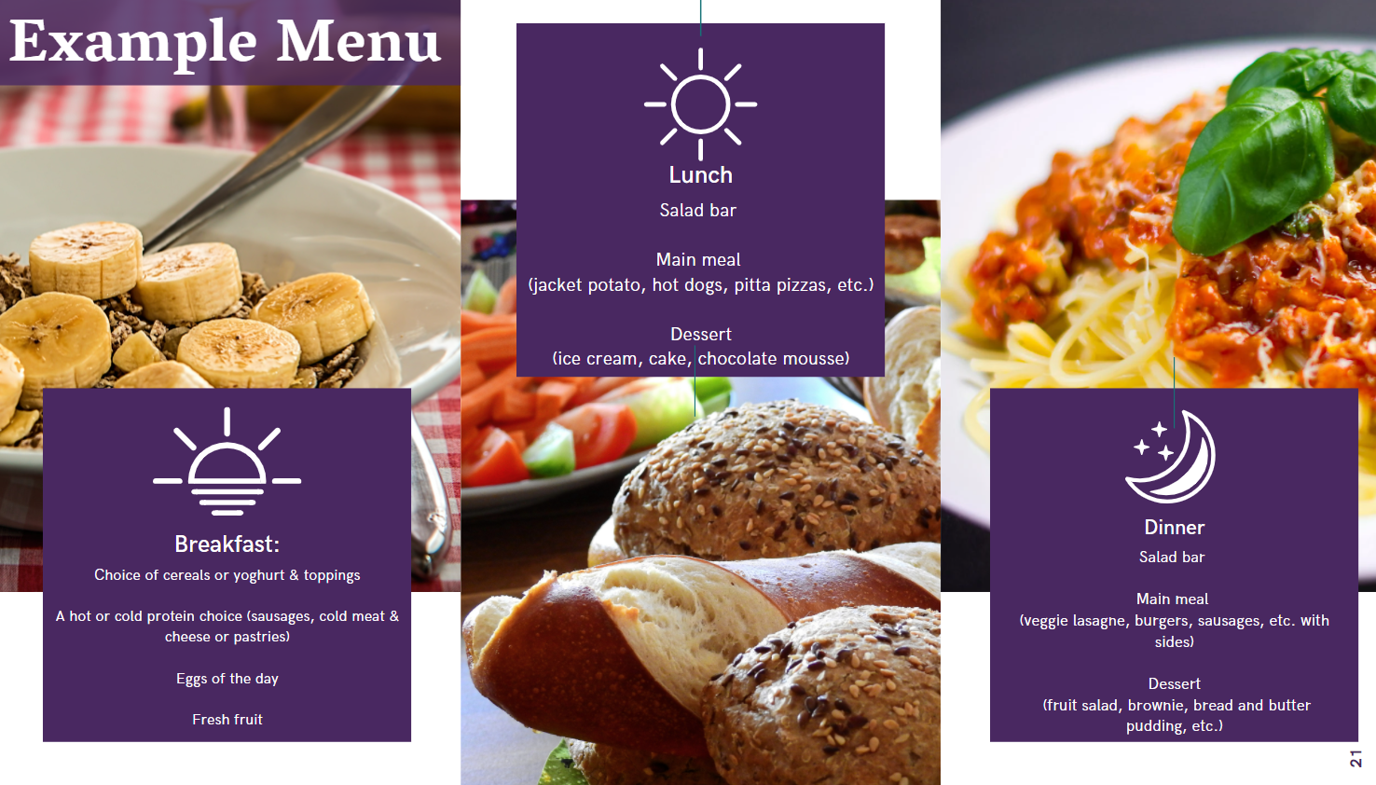

Slide 12
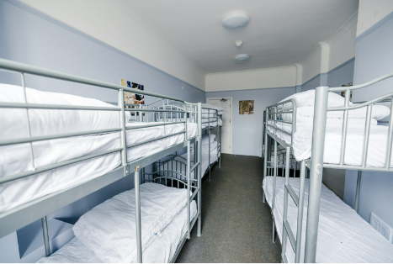
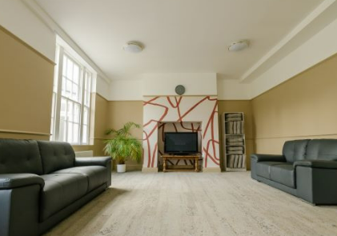
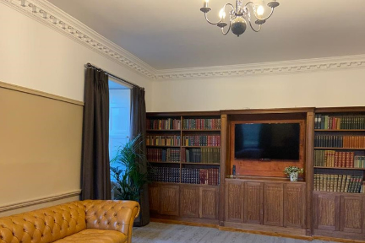
Accommodation
Together with at least one friend they have requested.
An adult on their floor.
Mix of bunk beds and single beds.

Slide 13
Arrival home- 7th March
We will be provided with breakfast and lunch on the day of departure.
We aim to be back at Homerswood by 3:10. Pick up will be at normal time and from our classroom.
Please keep an eye on school communications for updates on timings.

Slide 14
To do list
Ensure that all payments are up-to-date.
All consent forms completed.
Consider medication in advance and make suitable arrangements.

Slide 15

Any questions?

