Slide 1
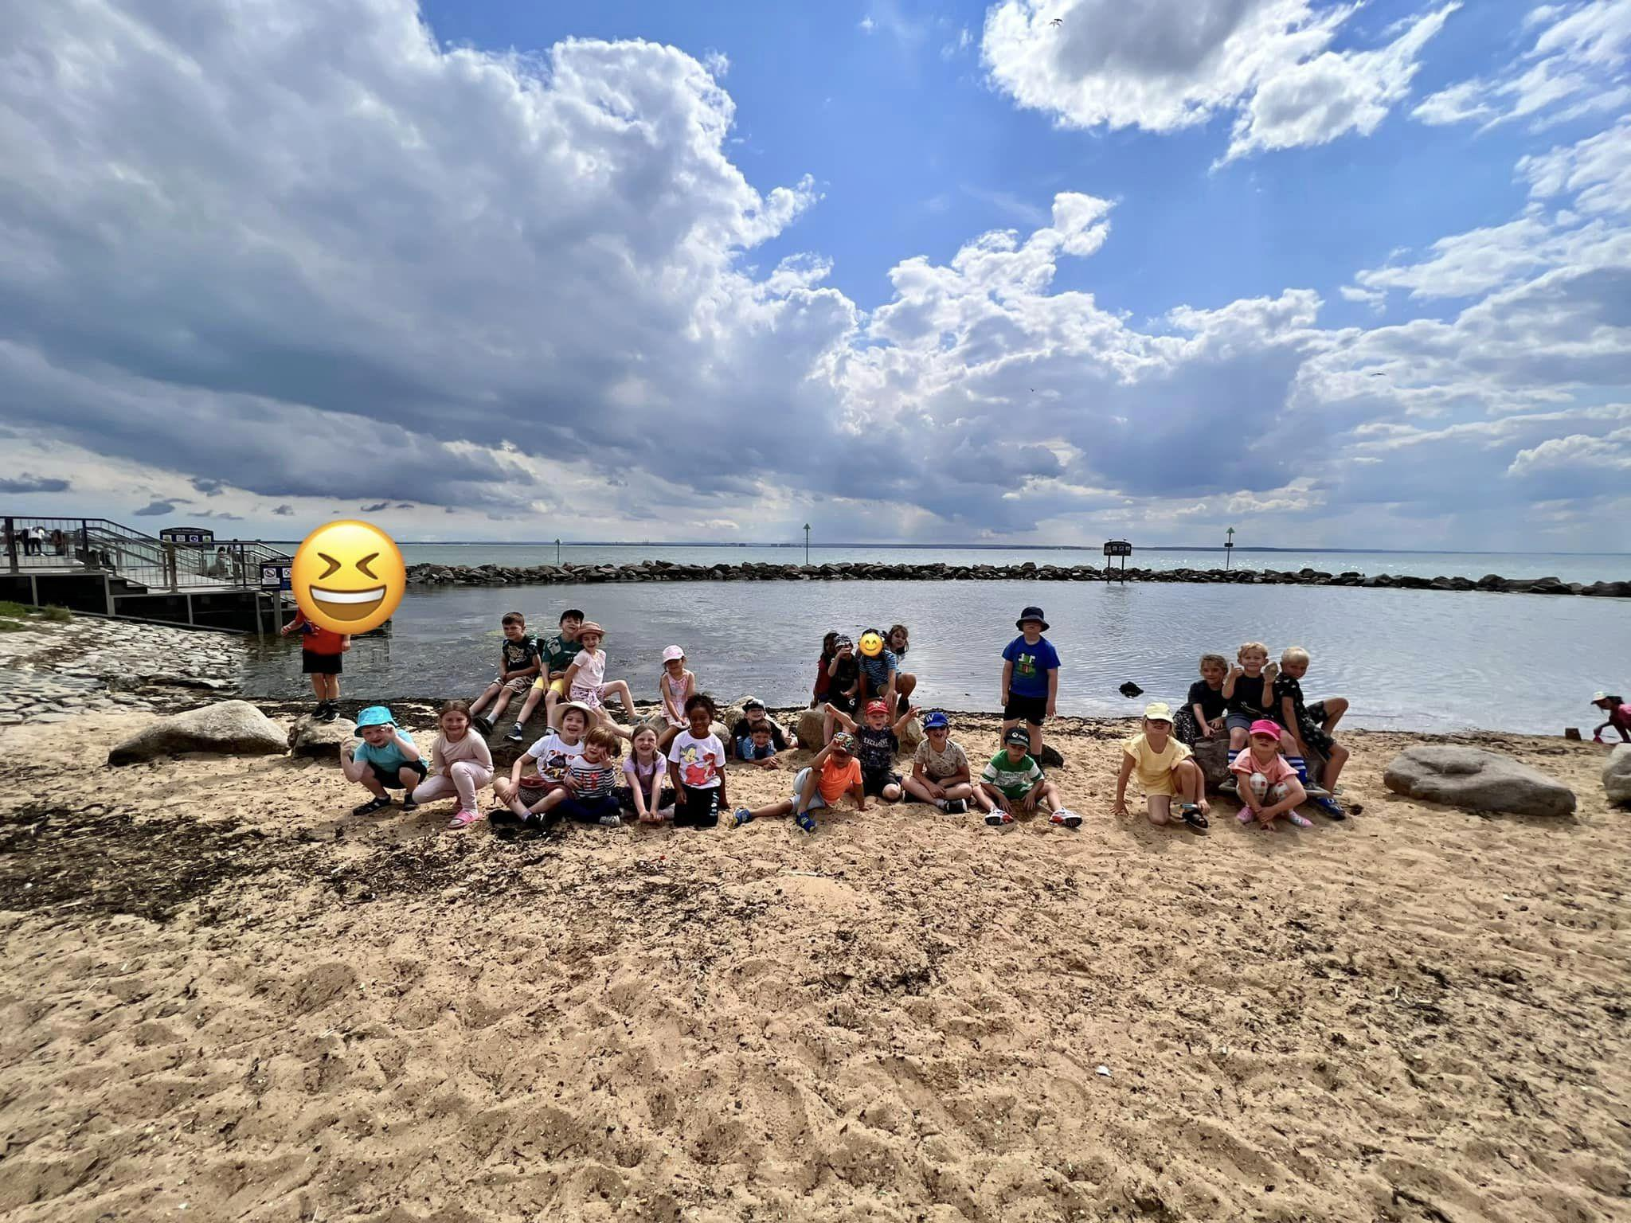

Slide 2
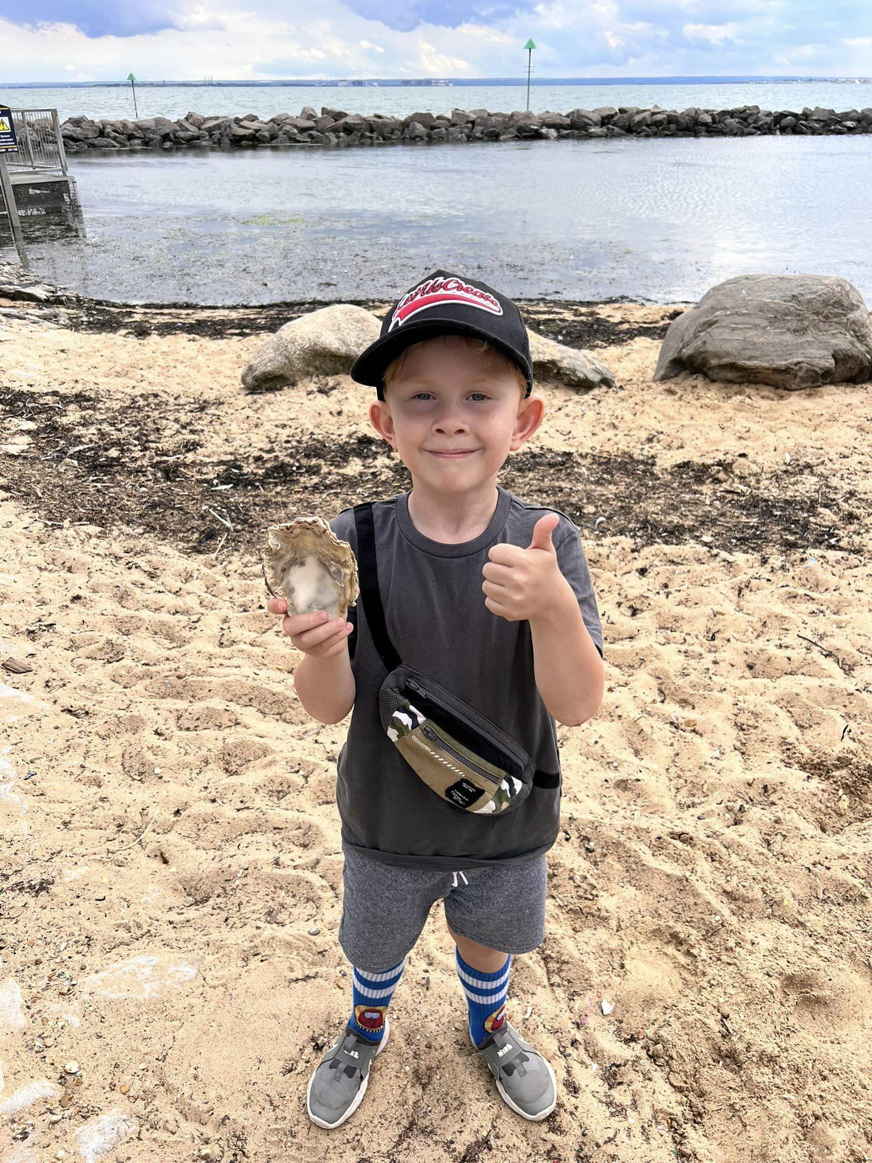
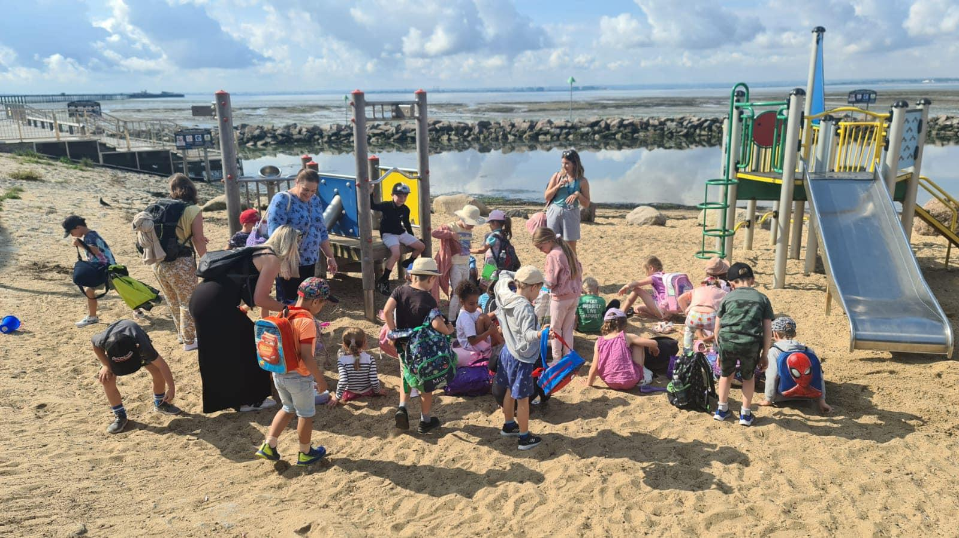

Slide 3
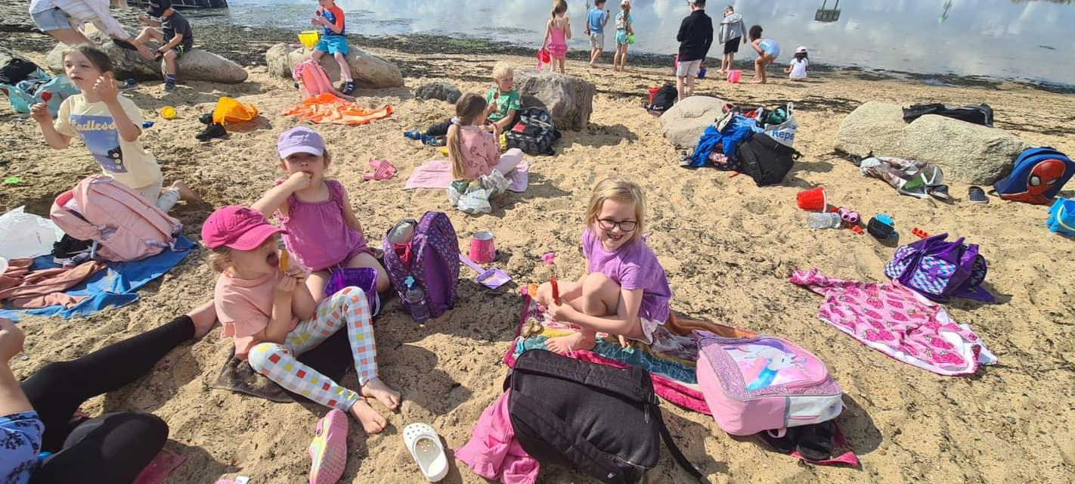

Slide 4
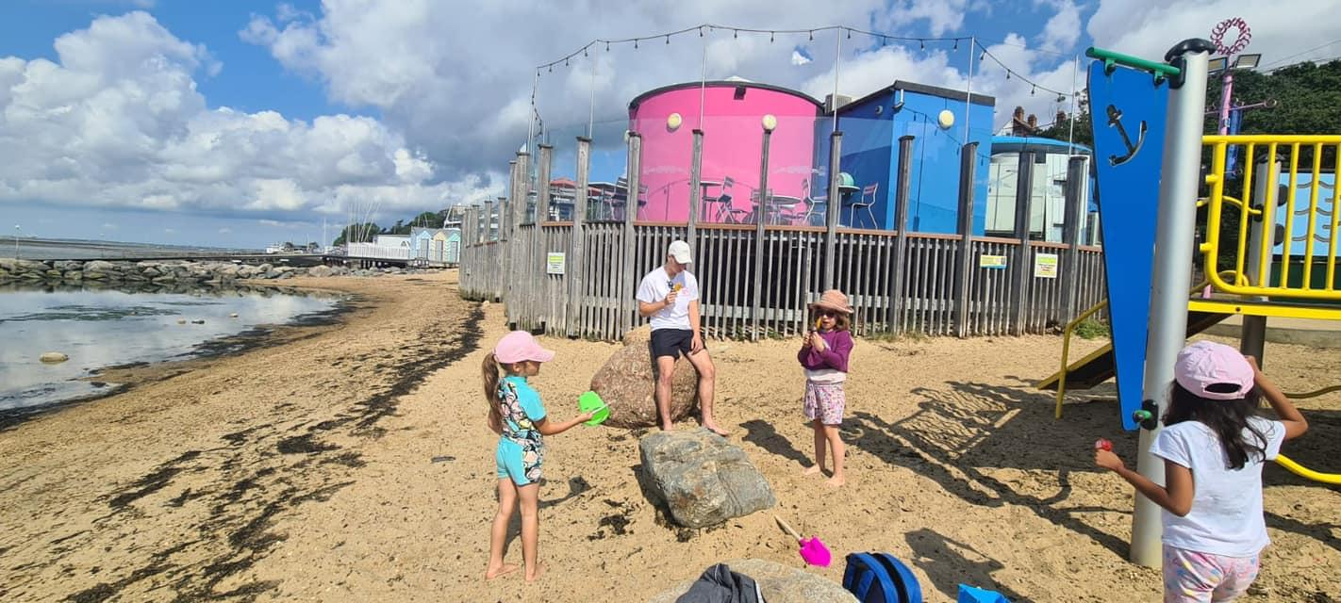

Slide 5
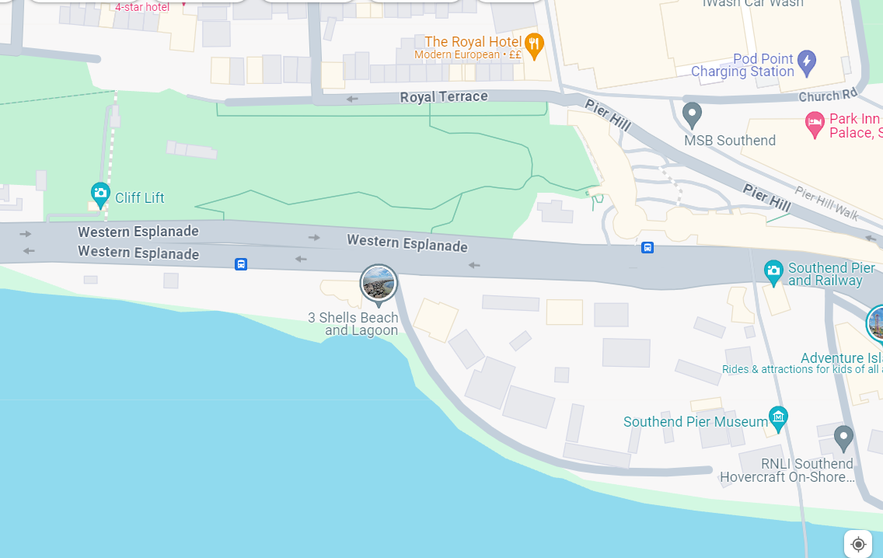

Slide 6
Itinerary
7:35: Classroom doors open (All children to go to the toilet before they leave, then children will be counted onto the coach)
8:00: Coach leaves the school
9:15-10:00 approx: Arrive at the beach
10:00: Children to reapply sun cream then have an ice lolly
10:30: Getting into swimwear (please put swimwear on under clothes)
11:00- Building sandcastles and paddling etc
12:00: Lunchtime and reapply sun cream
12:30: More time to enjoy the beach
14:00- Get ready to leave
14:15-14:30: Boarding the coach and a final count.
16:00 approx: Arrive back at school

Slide 7
Before you leave:
Make sure they have breakfast.
Please cover your child in water resistant sun cream before you put their swimwear on them.
Double check they have everything they need in their bag.
Encourage them to go to the toilet before they leave the house.
Ensure any medication your child has is in date.
Make sure you have updated emergency numbers with the office prior to the day.

Slide 8
Packing List
Water resistant sun cream!
Hat
Raincoat
Towel
Change of clothes (inc underwear)
Lunch- snacks and plenty of water
Beach appropriate footwear- ideally water shoes
One beach toy (bucket and spade etc)
Please refer to the email sent on 10th May with the full packing list and details.

Slide 9
Rain
If it does rain we will seek shelter for lunch but we will still be on the beach even in the rain. Please send your child with a raincoat just in case.

Slide 10
Coach and Adults
Reg’s 49 seater coach will be taking us. They will be waiting for us in Southend all day.
This means we are able to take 19 adults should we need them.
Adults Joining us:
Myself
Mrs Bohoran
Mrs Derisa
Miss Spear
Mrs Gregory/ Mrs Rowley
Mrs Wilson
4 Confirmed Extra Adults so far = 10 Total

