Slide 1
Phonics Information Session - 28/11/2024

Slide 2

Session Outlines:
What is phonics?
Phases within phonics
Reading and Assessment
Phonics Check (Year 1)
Questions

Slide 3
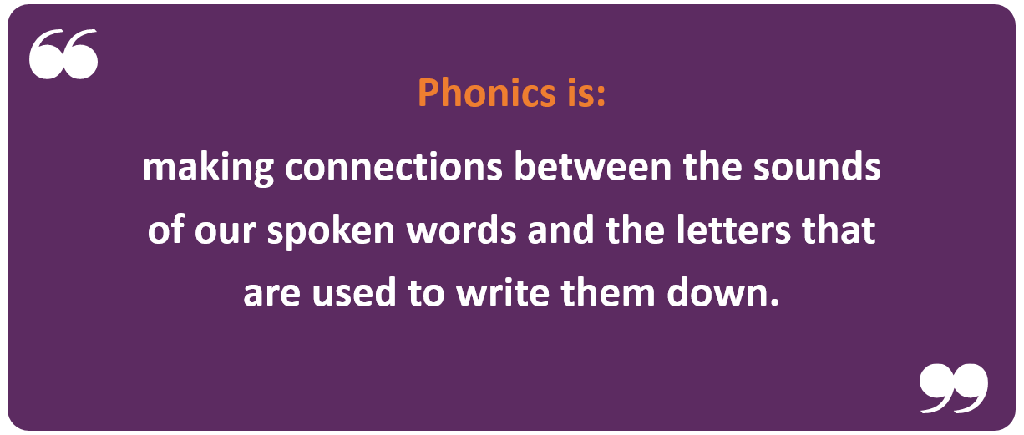

What is Phonics?
Phonics is a way of teaching children the skills to read effectively and to spell words. They are taught how to:
Recognise the sounds that each individual letter makes;
Identify the sounds that different combinations of letters make-such as “sh” “oo” “igh”
Blend these sounds together from left to right to make a word
Segment the sounds in words to spell them
Children can use this knowledge to “decode” new words that they
hear or see.

Slide 4

Why Phonics?
Research shows that when phonics is taught in a structured way-starting with the easiest sounds and progressing through to the most complex-it is the most effective way of teaching children to read.
Phonics in School…
Little Wandle
Taught daily (Reception-Year 2)
All staff are trained and supported by SLT

Slide 5

Saying the sounds…
https://www.littlewandlelettersandsounds.org.uk/resources/for-parents/

Slide 6
Terminology
Term | Definition
phoneme | The smallest unit of sound made in a word
grapheme | Letter/s used to represent a sound
blending | Putting sounds together to read
segmenting | Splitting a word in to single sounds
digraph | Two letters used to represent one sound
split digraph | When a digraph is split by a consonant
trigraph | Three letters used to represent one sound
phoneme frame | A grid used to support spelling splitting words into sounds
Dots and Dashes | Underneath sounds to support reading
tricky word | A word that cannot be decoded
.

Slide 7

Look out for…
Digraphs- 2 letters representing 1 sound (ck th ng) thing click
Trigraphs- 3 letters representing 1 sound (igh air ure) bright flair
Split diagraphs- contains 2 letters that are split between a consonant ( a-e i-e) make bike
When your children are reading the practise materials get them to sound button these specific letter groups e.g.

Slide 8
Little Wandle
Little Wandle is a phonics programme validated by the department of Education
Built around
the update announced from the DfE (2021)- improve rates of progress
latest research into how children learn best/most effectively
-how best to enable children to apply their learning to become competent and confident readers
.
Phase 1 – Nursery / Reception
Phase 2 – Reception
Phase 3 – Reception
Phase 4 – Reception
Phase 5 – Throughout Year 1
Notes:
What we do- transition

Slide 9

Phase 1
Phase 1 encourages the development of children’s speaking and listening skills. It is a vital part in laying the foundations in learning to read using phonics.
Aspects within Phase 1:
Environmental sounds
Instrumental sounds
Body percussion
Rhythm and rhyme
Alliteration
Voice sounds
Oral blending and segmenting

Slide 10
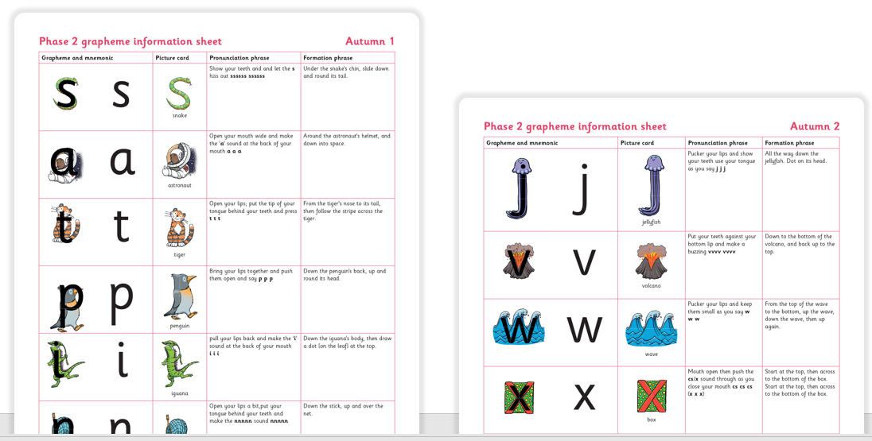
Phase 2
Phase 2 is the start of systematic phonics.
Begins the understanding of grapheme-phoneme correspondence.
Understand that words are constructed from phonemes and that phonemes are represented by graphemes.
There are 20 sounds in this phase
Notes:
Let them read the sounds aloud and we go round to listen to pronunciation i.e. ‘ner’ instead of ‘n’

Slide 11
Blending
The children begin to blend for reading.
s a t p i n
Using the phonemes they have learnt they start to read simple
words e.g. at, it, is, in.
They then move onto consonant-vowel-consonant (CVC) words
e.g. sat, pin, tap, pan.
Children need to be able to hear the separate sounds in a word
and then blend them together to say the whole word.

Slide 12
Segmenting
The children then begin to segment for writing.
s a t p i n
s/a/t = sat
p/i/n = pin
Children need to be able to hear a whole word and say every sound that they hear.
Segmenting is the opposite of blending.
Children will learn to use both terms blending and segmenting.

Slide 13
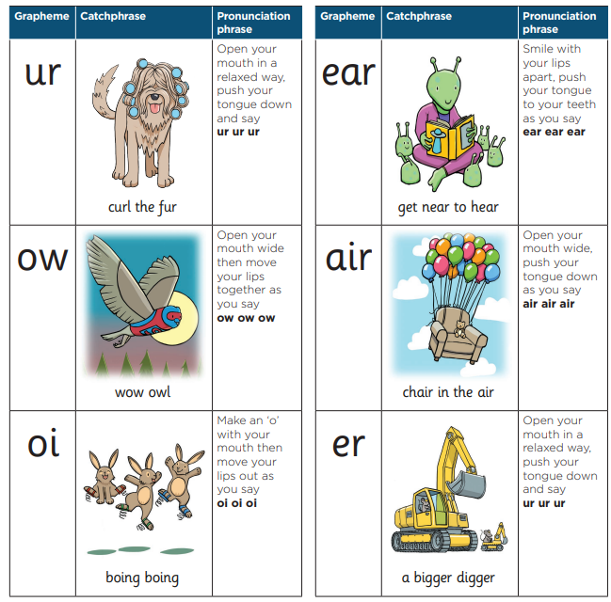
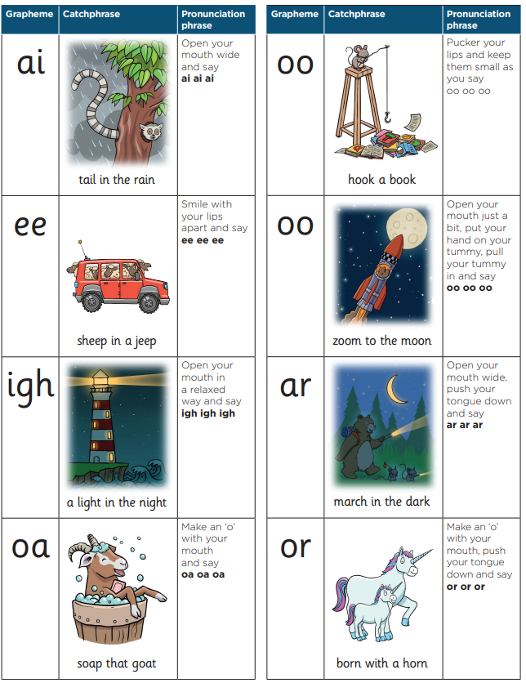
Phase 3
14 new sounds
They will apply these to the sounds previously learnt in Phase 2 to read and spell longer words containing:
-Two or more digraphs (chairs
etc)
-Compound words (sunset,
farmyard)

Slide 14
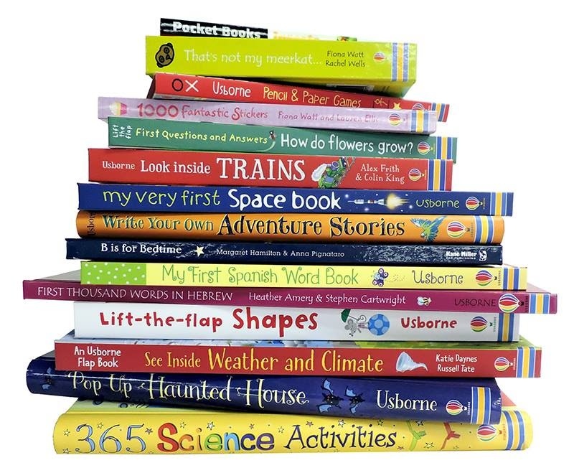
Phase 4
Does not introduce any new phonemes.
Reading and spelling words with four or more phonemes that they already know.
Longer words
Compound words
Words ending in a suffix –ing, -ed, -er etc

Slide 15

Phase 5
Review phase 3 and 4
Learn new graphemes for reading including split-diagraphs
Learn alternative pronunciation/spelling
meat/bread cow/blow bear/hear

Slide 16
Year 1
Phase 2
s igh ed
Phase 3

Slide 17
Phase 2
Year 3/4
c r ea ture
Phase 5

Slide 18

Tricky words
Most words in the English language can be worked out using phonics
Some exceptions- eg said
Learn by sight

Slide 19
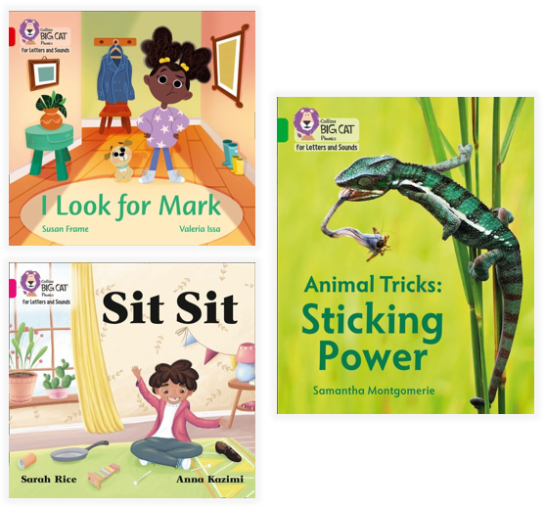
How do we teach reading in books?
Reading practice sessions are:
Timetabled x3 times a week (decode, prosody, comprehension)
Taught by a teacher/TA
Taught in small groups

Slide 20
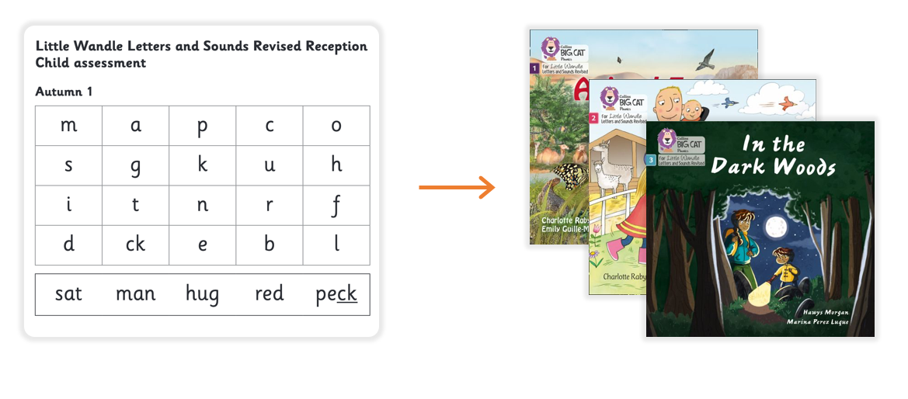
Assessment
We use continued and frequent assessment to match your child to the right level of book

Slide 21
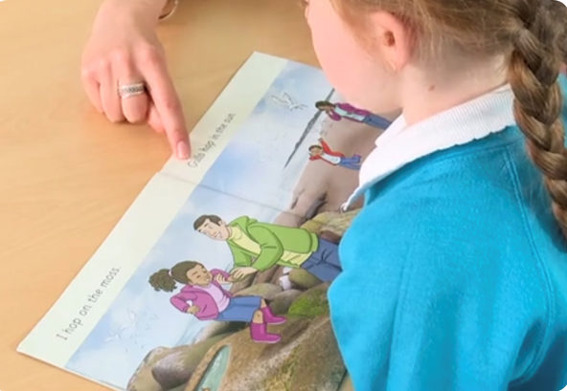
Reading a book at the correct level
This means that your child should:
Know all the sounds and tricky words in the phonics book well
Read many of the words by silent blending-their reading should begin to feel automatic
Only need to stop and sound out about 5% of the words by the end of their second read-but they should be able to do this on their own.
Answer questions using the text (not the pictures)

Slide 22
What is the phonics screening check?
The phonics screening check was introduced in 2012 in primary schools across England
It is a statutory check of children's phonics knowledge-all children in Year One will take it in the summer term
It helps the DfE to confirm whether children have made the expected progress in reading.

Slide 23

How does the check work?
Your child will sit with their class teacher and be asked to read aloud 40 words
Your child may have read some of these words before because they are “real”-whilst others are known as “alien” words and are completely new to them.
The check gets progressively more challenging
The check normally takes just a few minutes to complete and there is no time limit.
If your child is struggling-we will stop the check. It is carefully designed not to be stressful for your child.
Children will be in a familiar environment when taking the check and have already started using similar materials within their daily phonics lessons.

Slide 24
What are “nonsense words” or “alien words”?
The check will contain a combination of “real words” and “alien words”
Your child will be aware before the check that there will be “alien words” included. All children are familiar with these as we already use “alien words” when we teach phonics (words that are new to them).
These will be presented with an alien/figure next to them in the check.
“Alien words” are important to include because words such as “vap” or “jound” are new to all children. Children cannot read these type of words by using their memory or vocabulary; they have to use their phonic decoding skills. This is a fair way to assess their ability to decode.

Slide 25

The “alien words” are presented alongside a picture of an imaginary creature, and children can be told the non-word is the name of that type of creature. This helps children to understand that the non-word should not be matched to their existing vocabulary.

Slide 26
Any Questions?
Thank you

Slide 27
Useful Resources
https://www.gov.uk/government/collections/phonics - DFE documents
https://www.phonicsplay.co.uk/ - Some resources on the website are only available to subscribers however the planning sequences are free.
https://www.youtube.com/watch?v=-ksblMiliA8 - Pronunciation of sounds
https://www.topmarks.co.uk/english-games/5-7-years/letters-and-sounds - Games
https://www.phonicsbloom.com/ - Games
https://www.primarysupportteam.co.uk/files/phonics_at_ks2.pdf - Phonics in KS2
Notes:
Communication,
Language & Literacy
Development

